Slide 1

Welcome back! Link to Attendance Form ↓
bit.ly/a24-lec10

Slide 2
Recall: Template Functions
Turn to a partner and discuss:
What’s one thing you remember from Tuesday’s lecture on template functions?

Slide 3
Recall: Writing a min function
int min(int a, int b) {
return a < b ? a : b;
}
double min(double a, double b) {
return a < b ? a : b;
}
std::string min(std::string a, std::string b) {
return a < b ? a : b;
}
🧐

Slide 4
Recall: Writing a templated min function
template <typename T>
T min(T a, T b) {
return a < b ? a : b;
}
This is a template
T gets replaced with a specific type

Slide 5
Recall: explicit instantiation
Template functions cause the compiler to generate code for us
int min(int a, int b) { // Compiler generated
return a < b ? a : b; // Compiler generated
} // Compiler generated
double min(double a, double b) { // Compiler generated
return a < b ? a : b; // Compiler generated
} // Compiler generated
min<int>(106, 107); // Returns 106
min<double>(1.2, 3.4); // Returns 1.2

Slide 6
Recall: Writing a templated find function
This find function generalizes across all iterator types!
template <typename It, typename T>
It find(It begin, It end, const T& value) {
for (auto it = begin; it != end; ++it) {
if (*it == value) return it;
}
return end;
}

Slide 7
Recall: Writing a templated find function
Our find function works for other vectors, or even other containers
std::vector<std::string> v { "seven", "kingdoms" };
auto it = find(v.begin(), v.end(), "kingdoms");
// It = vector<std::string>::iterator
// T = std::string
std::set<std::string> s { "house", "targaryen" };
auto it = find(s.begin(), s.end(), "targaryen");
// It = std::set<std::string>::iterator
// T = std::string
Implicit Instantiation!
Compiler deduces template types by looking at arguments

Slide 8
Wait… why pass in iterators to find?

Slide 9
An alternative find function
We could have passed the whole container to find. Why not?
template <typename Container, typename T>
auto find(const Container& c, const T& value) {
for (auto it = c.begin(); it != c.end(); ++it) {
if (*it == value) return it;
}
return end;
}
std::vector<std::string> v { "seven", "kingdoms" };
auto it = find(v, "kingdoms");
Advantage: Now the caller doesn’t have to worry about begin and end!
Container = std::vector<std::string>
T = std::string

Slide 10
An alternative find function
Using iterators instead allows us to search only part of a container
std::vector<int> v { 106, 107, 106, 143, 149, 106 };
// Search for 106, skipping first and last elements
auto it = find(v.begin() + 1, v.end() - 1, 106);
// Get index of iterator using std::distance
std::cout << std::distance(v.begin(), it);
// Prints 2, not 0

Slide 11
We defined our find function in a general way!

Slide 12
How can we make find even more general!?
Our find searches for the first occurrence of value in a container
What if we wanted to find the first occurrence of:
A vowel in a string?
A prime number in a vector<int>?
A number divisible by 5 in a set<int>?

Slide 13
Lecture 10: Functions and Lambdas
CS106L, Autumn 2024

Slide 14
Today’s Agenda
Functions and Lambdas
How can we represent functions as variables in C++?
Algorithms
Revisiting an old algorithm you may have seen before in modern C++
Ranges and Views
A brand new (C++26), functional approach to C++ algorithms

Slide 16
Functions and Lambdas

Slide 17
Definition: A predicate is a boolean-valued function

Slide 18
Predicate Examples
Unary
Binary
bool isVowel(char c) {
c = toupper(c);
return c == 'A' || c == 'E’ ||
c == 'I' || c == 'O’ ||
c == 'U';
}
bool isPrime(size_t n) {
if (n < 2) return false;
for (auto i = 3; i<=sqrt(n); i++)
if (n % i == 0) return false;
return true;
}
bool isLessThan(int x, int y) {
return x < y;
}
bool isDivisible(int n, int d)
{
return n % d == 0;
}

Slide 19
Using predicates
How can we use isVowel to find the first vowel in a string?
Or isPrime to find a prime number in a vector<int>?
Or isDivisible to find a number divisible by 5?

Slide 20
Key Idea: We need to pass a predicate to a function

Slide 21
Modifying our find function
template <typename It, typename T>
It find(It first, It last, const T& value) {
for (auto it = first; it != last; ++it) {
if (*it == value) return it;
}
return last;
}
This condition worked for finding a specific value, but it’s too specific.
How can we modify it to handle a general condition?

Slide 22
Modifying our find function
template <typename It>
It find(It first, It last, ???? pred) {
for (auto it = first; it != last; ++it) {
if (*it == value) return it;
}
return last;
}
What if we could instead pass a predicate to this function as a parameter?

Slide 23
Modifying our find function
template <typename It>
It find(It first, It last, ???? pred) {
for (auto it = first; it != last; ++it) {
if (*it == value) return it;
}
return last;
}
What if we could instead pass a predicate to this function as a parameter?
Then we could replace this critical section of the code with a call to our predicate.

Slide 24
Modifying our find function
template <typename It>
It find(It first, It last, ???? pred) {
for (auto it = first; it != last; ++it) {
if (pred(*it)) return it;
}
return last;
}
What if we could instead pass a predicate to this function as a parameter?
Then we could replace this critical section of the code with a call to our predicate… like so!

Slide 25
Modifying our find function
Wait… what’s the type of this predicate?
template <typename It>
It find(It first, It last, ???? pred) {
for (auto it = first; it != last; ++it) {
if (pred(*it)) return it;
}
return last;
}
What if we could instead pass a predicate to this function as a parameter?
Then we could replace this critical section of the code with a call to our predicate… like so!

Slide 26
Answer: Templates plus predicates
Pred: the type of our predicate.
Compiler will figure this out for us using implicit instantiation!
template <typename It, typename Pred>
It find(It first, It last, Pred pred) {
for (auto it = first; it != last; ++it) {
if (pred(*it)) return it;
}
return last;
}
pred: our predicate, passed as a parameter
Hey look! We’re calling our predicate on each element. As soon as we find one that matches, we return

Slide 27
Answer: Templates plus predicates
Pred: the type of our predicate.
Compiler will figure this out for us using implicit instantiation!
template <typename It, typename Pred>
It find_if(It first, It last, Pred pred) {
for (auto it = first; it != last; ++it) {
if (pred(*it)) return it;
}
return last;
}
pred: our predicate, passed as a parameter
Hey look! We’re calling our predicate on each element. As soon as we find one that matches, we return
Let’s give this function a new name so it doesn’t get confused with old one!

Slide 29
Using our find_if function
bool isVowel(char c) {
c = ::toupper(c);
return c == 'A' || c == 'E' || c == 'I’ ||
c == 'O' || c == 'U’;
}
std::string corlys = "Lord of the Tides";
auto it = find_if(corlys.begin(), corlys.end(), isVowel);
*it = '0'; // “L0rd of the Tides”
You: ”What type is this?”
Compiler: “Don’t worry about it!”

Slide 30
Using our find_if function
bool isPrime(size_t n) {
if (n < 2) return false;
for (size_t i = 3; i <= std::sqrt(n); i++)
if (n % i == 0) return false;
return true;
}
std::vector<int> ints = {1, 0, 6};
auto it = find_if(ints.begin(), ints.end(), isPrime);
assert(it == ints.end());
You: ”What type is this!!?”
Compiler: “I gottttchuuu man”

Slide 31
Passing functions allows us to generalize an algorithm with user-defined behaviour

Slide 32
Aside: Seriously though, what is the type of Pred?

Slide 33
Pred is a function pointer
find_if(corlys.begin(), corlys.end(), isVowel);
// Pred = bool(*)(char)
find_if(ints.begin(), ints.end(), isPrime);
// Pred = bool(*)(int)
My function returns a bool
I’m a function pointer
And I take in a single int as a parameter
As we’ll see shortly, a function pointer is just one of the things we can pass to find_if

Slide 34
Function pointers generalize poorly
Consider that we want to find a number less than N in a vector
bool lessThan5(int x) { return x < 5; }
bool lessThan6(int x) { return x < 6; }
bool lessThan7(int x) { return x < 7; }
find_if(begin, end, lessThan5);
find_if(begin, end, lessThan6);
find_if(begin, end, lessThan7);

Slide 35
Function pointers generalize poorly
What if we want to find a number less than N, but we don’t know what N is until runtime?
int n;
std::cin >> n;
find_if(begin, end, /* lessThan... Haelpp... */)

Slide 36
We can’t just add another parameter
Turn to someone next to you and talk about why this wouldn’t work!
bool isLessThan(int elem, int n) {
return elem < n;
}

Slide 37
We can’t add another parameter to pred!
template <typename It, typename Pred>
It find_if(It first, It last, Pred pred) {
for (auto it = first; it != last; ++it) {
if (pred(*it)) return it;
}
return last;
}
We only pass one parameter to pred here!

Slide 38
We want to give our function extra state… …without introducing another parameter

Slide 39
Introducing… lambda functions
Lambda functions are functions that capture state from an enclosing scope
int n;
std::cin >> n;
auto lessThanN = [n](int x) { return x < n; };
find_if(begin, end, lessThanN); // 😎 😎

Slide 40
Lambda Syntax
I don’t know the type! But the compiler does.
Capture clause lets us use outside variables
Parameters
Function parameters, exactly like a normal function
auto lessThanN = [n](int x) {
return x < n;
};
Function body
Exactly as a normal function, except only parameters and captures are in-scope

Slide 41
A note on captures
auto lambda = [capture-values](arguments) {
return expression;
}
[x](arguments) // captures x by value (makes a copy)
[x&](arguments) // captures x by reference
[x, y](arguments) // captures x, y by value
[&](arguments) // captures everything by reference
[&, x](arguments) // captures everything except x by reference
[=](arguments) // captures everything by value

Slide 42
We don’t have to use captures!
Lambdas are good for making functions on the fly
std::string corlys = "Lord of the tides";
auto it = find_if(corlys.begin(), corlys.end(),
[](auto c) {
c = toupper(c);
return c == 'A' || c == 'E' ||
c == 'I' || c == 'O' || c == 'U’;
});

Slide 44
How do lambdas work?

Slide 45
Recall: The Standard Template Library (STL)
Containers
How do we store groups of things?
Iterators
How do we traverse containers?
Functors
How can we represent functions as objects?
Algorithms
How do we transform and modify containers in a generic way?

Slide 46
Definition: A functor is any object that defines an operator()
In English: an object that acts like a function

Slide 47
An example of a functor: std::greater<T>
template <typename T>
struct std::greater {
bool operator()(const T& a, const T& b) const {
return a > b;
}
};
std::greater<int> g;
g(1, 2); // false
Hmm.. Seems like a function
🦆🦆

Slide 48
Another STL functor: std::hash<T>
Aside: This syntax is called a template specialization for type MyType
template <>
struct std::hash<MyType> {
size_t operator()(const MyType& v) const {
// Crazy, theoretically rigorous hash function
// approved by 7 PhDs and Donald Knuth goes here
return ...;
}
};
MyType m;
std::hash<MyType> hash_fn;
hash_fn(m); // 125123201 (for example)
Hint hint: This is also one of the ways to create a hash function for a custom type

Slide 49
Since a functor is an object, it can have state

Slide 50
Functors can have state!
struct my_functor {
bool operator()(int a) const {
return a * value;
}
int value;
};
my_functor f;
f.value = 5;
f(10); // 50
Oooh such state
🥹🥹

Slide 51
Time for a dark secret 👻🧙‍♀️🧪

Slide 52
When you use a lambda, a functor type is generated

Slide 53
This code…
int n = 10;
auto lessThanN = [n](int x) { return x < n; };
find_if(begin, end, lessThanN);

Slide 54
…is equivalent to this code!
Random name that only the compiler will see!
Recall: functor call operator
class __lambda_6_18
{
public:
bool operator()(int x) const { return x < n; }
__lambda_6_18(int& _n) : n{_n} {}
private:
int n;
};
int n = 10;
auto lessThanN = __lambda_6_18{ n };
find_if(begin, end, lessThanN);
Class constructor
Our captures became fields in the class!
Capturing variable n from outer scope by passing to constructor
If you are curious about this stuff, check out https://cppinsights.io/!

Slide 55
You’ve seen this kind of thing before…
std::vector<int> v {1,2,3};
for (const int& e : v)
{
// ...
}
auto begin = v.begin();
auto end = v.end();
for (auto it = begin; it != end; ++it)
{
// ...
}

Slide 56
It’s the same ordeal! Syntactic sugar
int n = 10;
auto lessThanN = [n](int x)
{ return x < n; };
find_if(begin, end, lessThanN);
class __lambda_6_18
{
public:
bool operator()(int x) const
{ return x < n; }
__lambda_6_18(int& _n) : n{_n} {}
private:
int n;
};
int n = 10;
auto lessThanN = __lambda_6_18{n};
find_if(begin, end, lessThanN);

Slide 57
Functions & Lambdas Recap
Use functions/lambdas to pass around behaviour as variables
Aside: std::function is an overarching type for functions/lambdas
Any functor/lambda/function pointer can be cast to it
It is a bit slower
I usually use auto/templates and don’t worry about the types!
std::function<bool(int, int)> less = std::less<int>{};
std::function<bool(char)> vowel = isVowel;
std::function<int(int)> twice = [](int x) { return x * 2; };

Slide 59
Where do we use functions & lambdas?

Slide 60
Algorithms

Slide 61
Recall: The Standard Template Library (STL)
Containers
How do we store groups of things?
Iterators
How do we traverse containers?
Functors
How can we represent functions as objects?
Algorithms
How do we transform and modify containers in a generic way?

Slide 62
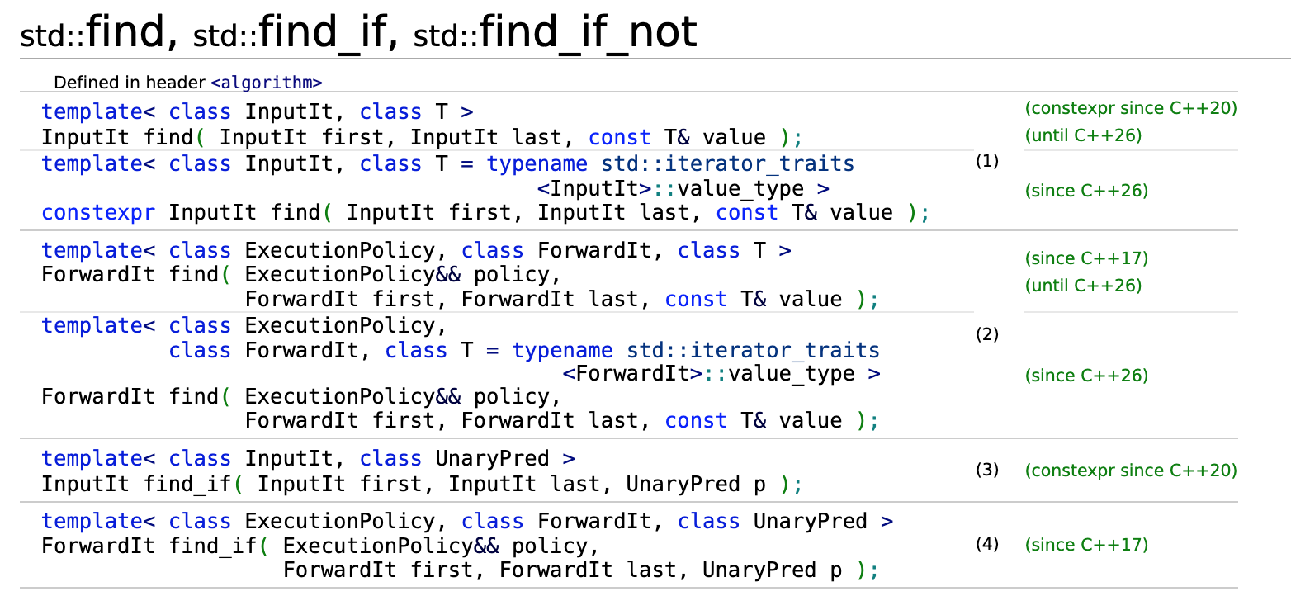
Huh… that looks familiar

Slide 63
<algorithm> is a collection of template functions
std::count_if(InputIt first, InputIt last, UnaryPred p);
How many elements in [first, last] match predicate p?
std::sort(RandomIt first, RandomIt last, Compare comp);
Sorts the elements in [first, last) according to comparison comp
std::max_element(ForwardIt first, ForwardIt last, Compare comp);
Finds the maximum element in [first, last] according to comparison comp

Slide 64
<algorithm> functions operate on iterators
std::copy_if(InputIt r1, InputIt r2, OutputIt o, UnaryPred p);
Copy the only elements in [r1, r2) into o which meet predicate p
std::transform(ForwardIt1 r1, ForwardIt1 r2, ForwardIt2 o, UnaryOp op);
Apply op to each element in [r1, r2), writing a new sequence into o
std::unique_copy(InputIt i1, InputIt i2, OutputIt o, BinaryPred p);
Remove consecutive duplicates from [r1, r2), writing new sequence into o

Slide 65
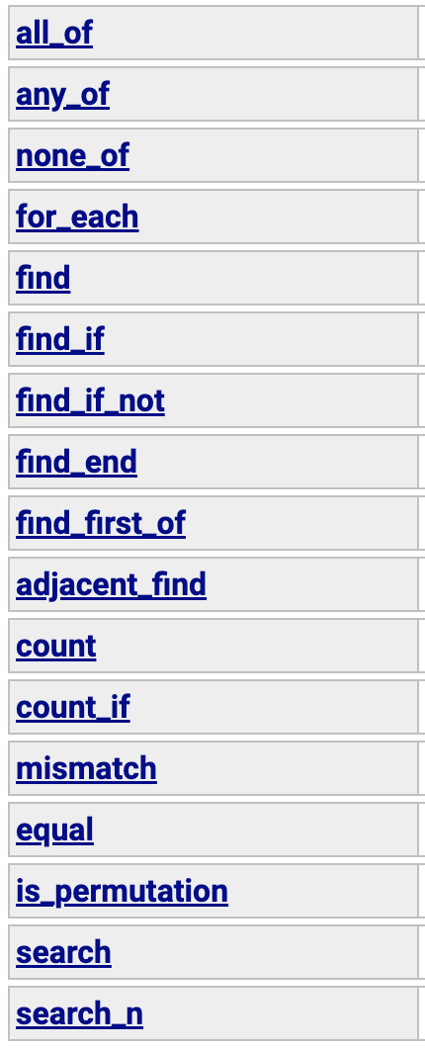
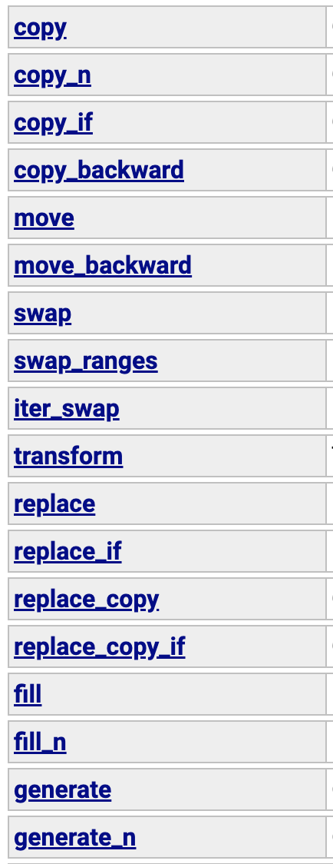
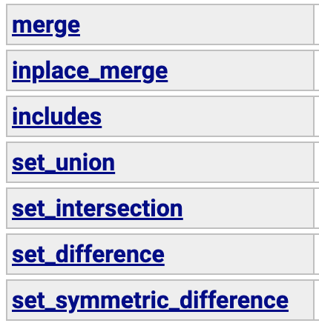
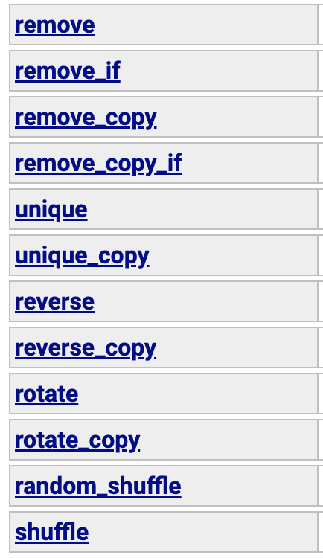
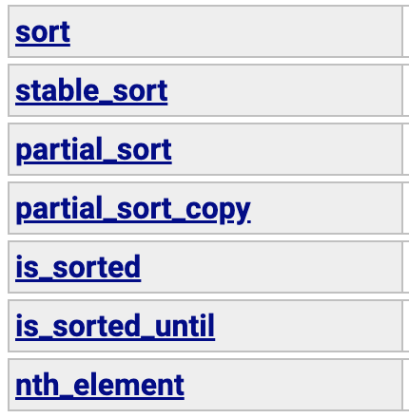
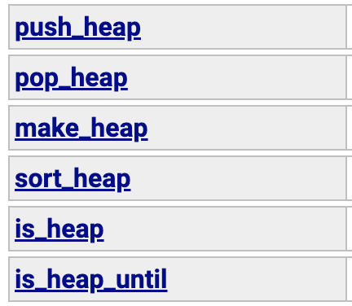
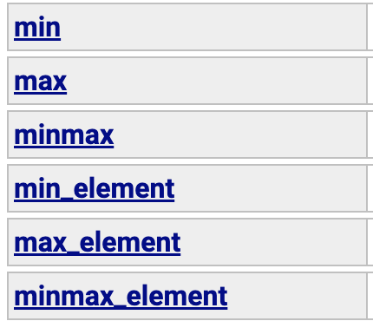
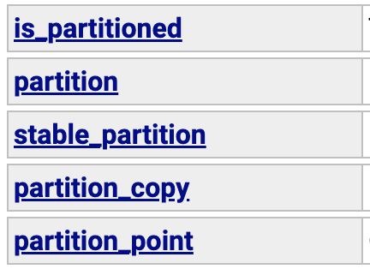
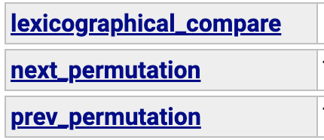
There are a lot of algorithms…

Slide 66
Things you can do with the STL binary search • heap building • min/max lexicographical comparisons • merge • set union • set difference • set intersection • partition • sort nth sorted element • shuffle • selective removal • selective copy • for-each • random sample all in their most general form!

Slide 68
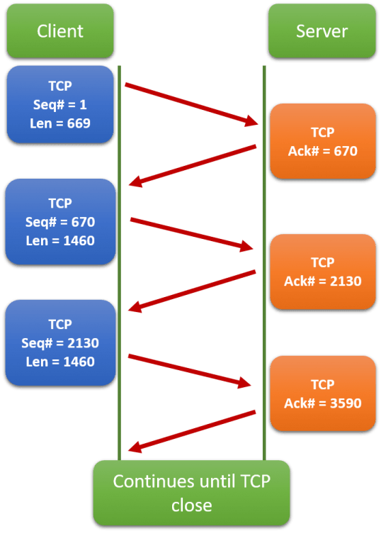

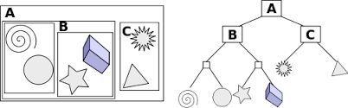
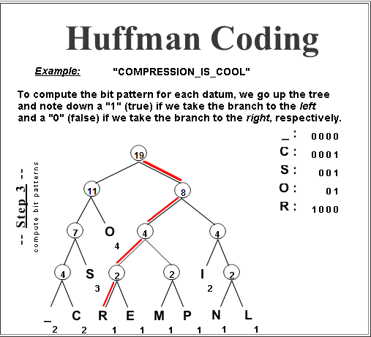
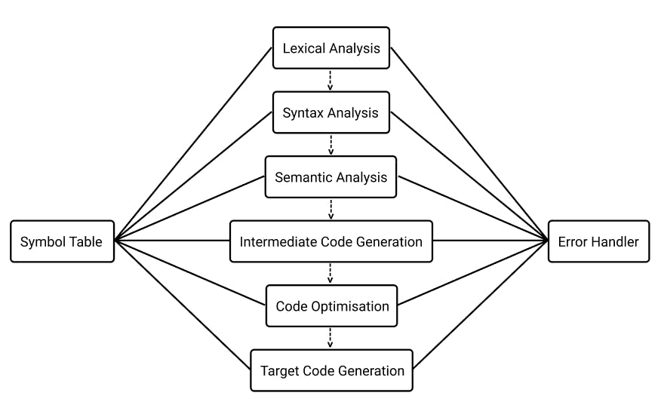

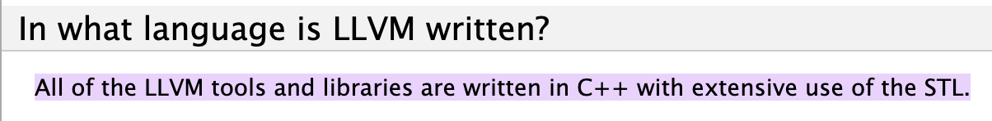
<algorithm> lets us inspect and transform data

Slide 69
Let’s write an algorithm using the STL!

Slide 70
Soundex!! 🔊🔊

Slide 71
Goal: produce a phonetic encoding for names
“Roberts”
“R163”
“Rupert”

Slide 72
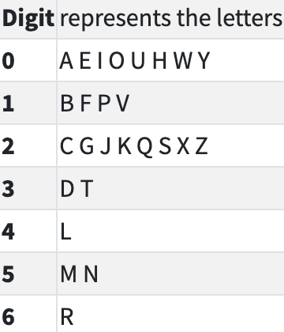
How do we implement soundex?
Roberts-
Given a string s, extract the letters from s
Replace each letter with its soundex encoding
Coalesce adjacent duplicates (222025 becomes 2025)
Replace first digit with the uppercase first letter of s
Discard any zeros from the code
Make the code exactly length 4 (truncate or zero-pad)
Roberts
6010632
6010632
R010632
R1632
R163

Slide 73
Let’s implement Soundex with the STL!

Slide 75
Can we make our Soundex more readable?

Slide 76
Ranges and Views

Slide 77
Ranges are a new version of the STL

Slide 78
Definition: A range is anything with a begin and end

Slide 79
What’s a range?
std::unordered_set<K,V>
std::vector<T>
Your own custom type with a begin and end!
std::map<K, V>
std::set<K>

Slide 80
Recall: why did we pass iterators to find?
It allows us to find in a subrange! But most of the time, we don’t need to.
int main() {
std::vector<char> v = {'a', 'b', 'c', 'd', 'e’};
auto it = std::find(v.begin(), v.end(), 'c');
}
Do we really care about iterators here? I just wanted to search the entire container!

Slide 81
Range algorithms operate on ranges
STD ranges provides new versions of <algorithm> for ranges
int main() {
std::vector<char> v = {'a', 'b', 'c', 'd', 'e’};
auto it = std::ranges::find(v, 'c');
}
Look! I can pass v here because it is a range!

Slide 82
Range algorithms operate on ranges
We can still work with iterators if we need to
int main() {
std::vector<char> v = {'a', 'b', 'c', 'd', 'e'};
// Search from 'b' to 'd’
auto first = v.begin() + 1;
auto last = v.end() - 1;
auto it = std::ranges::find(first, last, 'c');
}

Slide 83
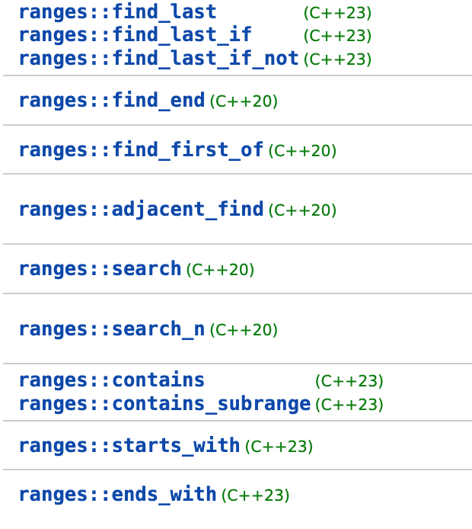
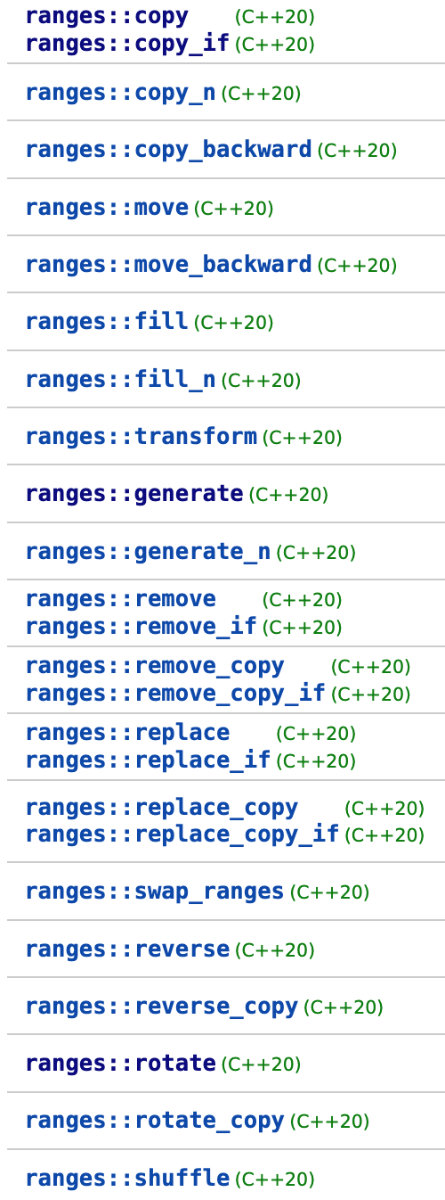
Ranges: The STL v2
There are range equivalents of most of the STL <algorithm> library
These are very new! C++20/23/26 and beyond!

Slide 84
Range algorithms are constrained
That just means they make use of the new STL concepts! Remember them?
A range has a begin and end! :)
template<class T>
concept range = requires(T& t) { ranges::begin(t); ranges::end (t); };
template<class T>
concept input_range =
ranges::range<T> && std::input_iterator<ranges::iterator_t<T>>;
template<ranges::input_range R, class T, class Proj = std::identity>
borrowed_iterator_t<R> find( R&& r, const T& value, Proj proj = {} );
An input range is a range using an input iterator
I’ve cut out some of the code here, but notice that ranges find uses concepts!!

Slide 85
Ranges Recap
Ranges use concepts! Better error messages, what’s not to like?
We can pass entire containers

Slide 87
Ranges Recap
Ranges use concepts! Better error messages, what’s not to like?
We can pass entire containers
Okay… is that it? 👁👁

Slide 88
Views: a way to compose algorithms

Slide 89
Definition: A view is a range that lazily adapts another range

Slide 90
Filter and transform in the old STL
This code is a bit awkward in the current STL
std::vector<char> v = {'a', 'b', 'c', 'd', 'e'};
// Filter -- Get only the vowels
std::vector<char> f;
std::copy_if(v.begin(), v.end(), std::back_inserter(f), isVowel);
// Transform -- Convert to uppercase
std::vector<char> t;
std::transform(f.begin(), f.end(), std::back_inserter(t), toupper);
// { 'A', 'E' }

Slide 91
Filter and transform with views!
A view is a range that lazily transforms its underlying range, one element at a time
std::vector<char> letters = {'a', 'b', 'c', 'd', 'e’};
auto f = std::ranges::views::filter(letters, isVowel);
auto t = std::ranges::views::transform(f, toupper);
auto vowelUpper = std::ranges::to<std::vector<char>>(t);

Slide 92
Views are composable
auto f = std::ranges::views::filter(letters, isVowel);
// f is a view! It takes an underlying range letters
// and yields a new range with only vowels!
auto t = std::ranges::views::transform(f, toupper);
// t is a view! It takes an underlying range f
// and yields a new range with uppercase chars!
auto vowelUpper = std::ranges::to<std::vector<char>>(t);
// Here we materialize the view into a vector!
// Nothing actually happens until this line!

Slide 93
We can chain views together use operator|
std::vector<char> letters = {'a','b','c','d','e'};
std::vector<char> upperVowel = letters
| std::ranges::views::filter(isVowel)
| std::ranges::views::transform(toupper)
| std::ranges::to<std::vector<char>>();
// upperVowel = { 'A', 'E' }

Slide 94

Remember: range algorithms are eager
std::ranges are a reskin of the old STL algorithms
// This actually sorts vec, RIGHT NOWWW!!!!
std::ranges::sort(v);

Slide 95

Remember: views are lazy
std::ranges::views are a lazy way of composing algorithms
auto view = letters
| std::ranges::views::filter(isVowel)
| std::ranges::views::transform(toupper)
std::vector<char> upperVowel =
std::ranges::to<std::vector<char>>(view);

Slide 96
Pro tip: Views are like Python generators
This code in C++ works exactly the same as this Python code
auto view = letters
| std::ranges::views::filter(isVowel)
| std::ranges::views::transform(toupper); auto upperVowel = std::ranges::to<std::vector<char>>(view);
view = (l for l in letters if isVowel(l)) # Lazy evaluation
view = (l.upper() for l in view) # Lazy evaluation
upperVowel = list(view)

Slide 98
What would Soundex with views look like?

Slide 99
Ranges and view recap
Why you might like ranges/views?
✅ Worry less about iterators
✅ Constrained algorithms mean better error messages
✅ Super readable, functional syntax
Why you might dislike ranges/views?
❌ They are extremely new, not fully feature complete yet
❌ Lack of compiler support
❌ Loss of performance compared to hand-coded version
ℹ️ For more info, see The Terrible Problem of Incrementing a Smart Iterator

Slide 100
Soundex: C++26?
Once views are fully implemented, our Soundex code might look like this
namespace rng = std::ranges;
namespace rv = std::ranges::views;
auto ch = *rng::find_if(s, isalpha); // Get first letter
auto sx = s | rv::filter(isalpha) // Discard non-letters
| rv::transform(soundexEncode) // Encode letters
| rv::unique // Remove duplicates
| rv::filter(notZero) // Remove zeros
| rv::concat("0000") // Ensure length >= 4
| rv::drop(1) // Skip first digit
| rv::take(3) // Take next three
| rng::to<std::string>(); // Convert to string
return toupper(ch) + v;

